Slide 1
YOUR FIRST SPARK PROGRAM In Python
Running your first Spark job!

Slide 2
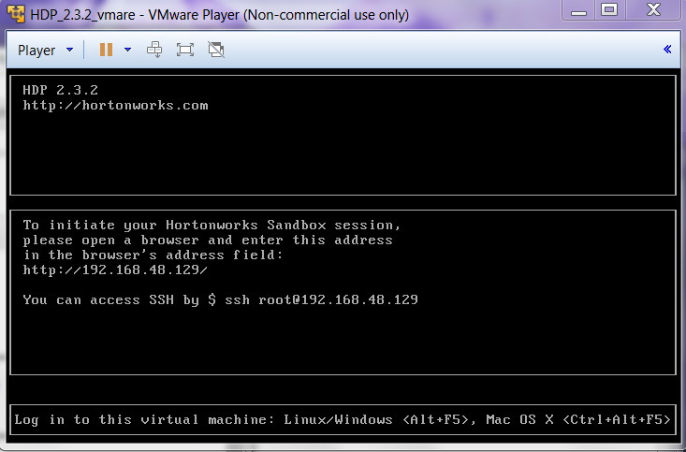
Getting Ready
Ensure your Hortonworks Data Platform toolbox is running
Login to Linux
Use PuTTY on Windows
Use Zeppelin notebooks/interpreters from a Windows browser
Use the Linux console in the VM
Load data files into Hadoop file system (hdfs)
Open a Python Spark shell
Set up, run a sample Python Spark use case
Set up, run a Spark SQL sample use case

Slide 3
Exercise and More Information
Based on the Quick Start Guide at:
http://hortonworks.com/hadoop-tutorial/hands-on-tour-of-apache-spark-in-5-minutes/
Note: Warning levels for Spark reduced from “INFO” to “WARN” in /etc/spark/2.3.2.0-2950/0/log4j.properties
Supporting information and exercises:
http://spark.apache.org/docs/latest/quick-start.html
http://hortonworks.com/hadoop-tutorial/using-commandline-manage-files-hdfs/

Slide 4
Get the file from Wikipedia:
wget http://en.wikipedia.org/wiki/Hortonworks
Store in HDFS:
hadoop fs -put ~/Hortonworks /tmp/Hortonworks
Start the Python Spark shell:
pyspark

Slide 5
Create an RDD with the file from HDFS using a Spark Context (already created when the shell started):
myData = sc.textFile('hdfs://sandbox.hortonworks.com/tmp/Hortonworks')
Run 2 transformations, filtering out empty lines (0 length) and lines with “Horton”:
myFilteredLines = myData.filter( lambda x: len(x) > 0 )
myHortonLines = myData.filter( lambda line: ‘Horton’ in line)
Note that nothing happens! Lazy… but building a DAG / processing graph

Slide 6
Make something happen
This will make both filters happen, count the lines, and display the first line of the second RDD:
myFilteredLines.count()
myHortonLines.first()

Slide 7
Chain transformations
Key to Spark performance is chaining transformations and actions
Though in our simple example it happens this way anyway:
myData.filter(lambda line: “Horton" in line).count()
Far more complex transformations can be put together before actions

Slide 8
Once code works, move onto deployment and scaling
Worker
RDD
Cache
Driver
Worker
RDD
Cache
Worker
RDD
Cache

Slide 9
Cluster wide, in memory cache
Data sets in a cluster-wide in-memory cache are very useful when data is accessed repeatedly
Examples: Querying a small “hot” dataset or when running an iterative algorithm like PageRank. Mark the linesWithHorton dataset to be cached:
>>> linesWithHorton.cache()
Now functions run on linesWithHorton will run extremely fast (from memory). Scaling to very large data sets is possible - striped across tens or hundreds of nodes

Slide 10
MapReduce
One common data flow pattern is MapReduce from Hadoop
Spark implements MapReduce flows simply
Example:
>>> wordCounts = textFile.flatMap(lambda line: line.split()).map(lambda word: (word, 1)).reduceByKey(lambda a, b: a+b)

Slide 11
Further Reading
A more detailed discussion of RDDs:
http://spark.apache.org/docs/latest/programming-guide.html

Slide 12
Your First Spark SQL Job!

Slide 13
DataFrames
A DataFrame is a distributed collection of data organized into named columns.
Conceptually equivalent to a table in a relational database or a data frame in R/Python, but with richer optimizations under the hood.
DataFrames can be constructed from a wide array of sources such as: structured data files, tables in Hive/SQL, external databases, or existing RDDs.

Slide 14
Getting from RDD to DataFrame
Spark SQL can infer the datatypes as it converts an RDD of Row objects to a DataFrame
The keys of this list:
define the column names of the table
types are inferred by looking at attributes of the first row

Slide 15
Example source:
http://spark.apache.org/docs/latest/sql-programming-guide.html
Step 1: Load the data into HDSF:
hadoop fs -put /usr/hdp/2.3.2.0-2950/spark/examples/src/main/resources/people.txt /tmp/people.txt

Slide 16
Python Spark SQL
Entry point into all relational functionality: the SQLContext class, or one of its decedents.
from pyspark.sql import SQLContext, Row
sqlContext = SQLContext(sc)
*Note: you can also create a HiveContext, which provides a superset of the functionality

Slide 17
# Load the text file; convert each line to an RDD Row.
lines = sc.textFile("/tmp/people.txt")
rowparts = lines.map(lambda l: l.split(","))
people = rowparts.map(lambda p: Row(name=p[0], age=int(p[1])))
# Infer the schema, and register the DataFrame as a table.
schemaPeople = sqlContext.createDataFrame(people)
schemaPeople.registerTempTable("people")

Slide 18
# SQL can be run over DataFrames that have been registered as a table.
notteenagers = sqlContext.sql("SELECT name FROM people WHERE age > 19")
# The results of SQL queries are RDDs and support all the normal RDD operations.
olderNames = notteenagers.map(lambda p: "Name: " + p.name)
for olderName in olderNames.collect():
print(olderName)

Slide 19
Summary
Spark, Python, and SQL are powerful partners in productivity
Spark RDD’s provide a powerful tool for scalability and speed

